Slide 1
Module 4

Slide 2
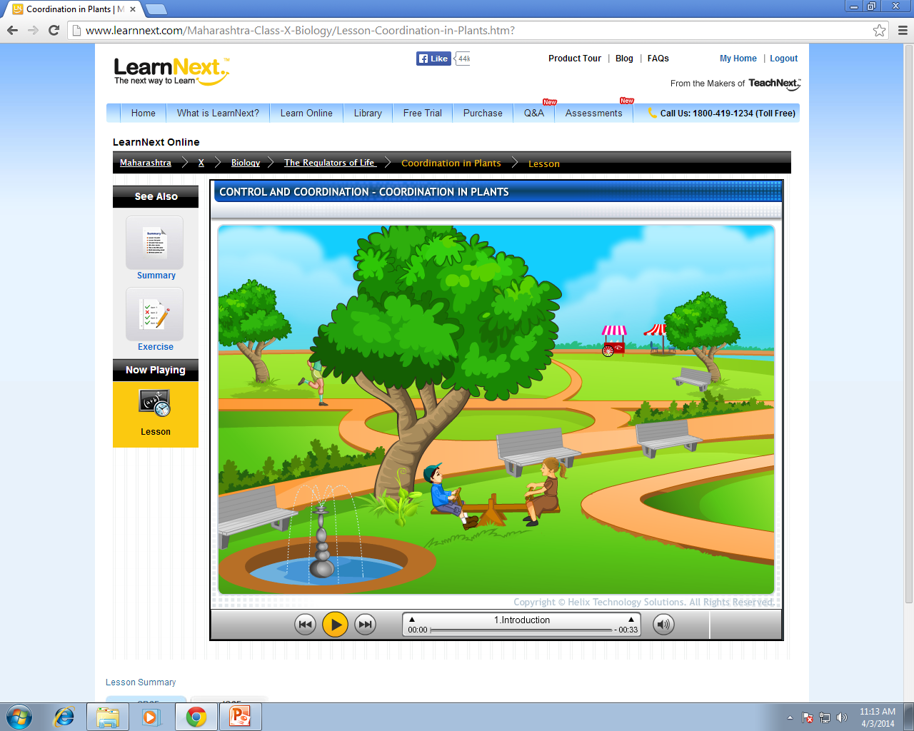













What can you see from the picture ?
Animals can move from one place to another and this motion is called as Locomotion
But the answer is YES
Can plants move ?
NO
Can animals move ?
YES

Slide 3
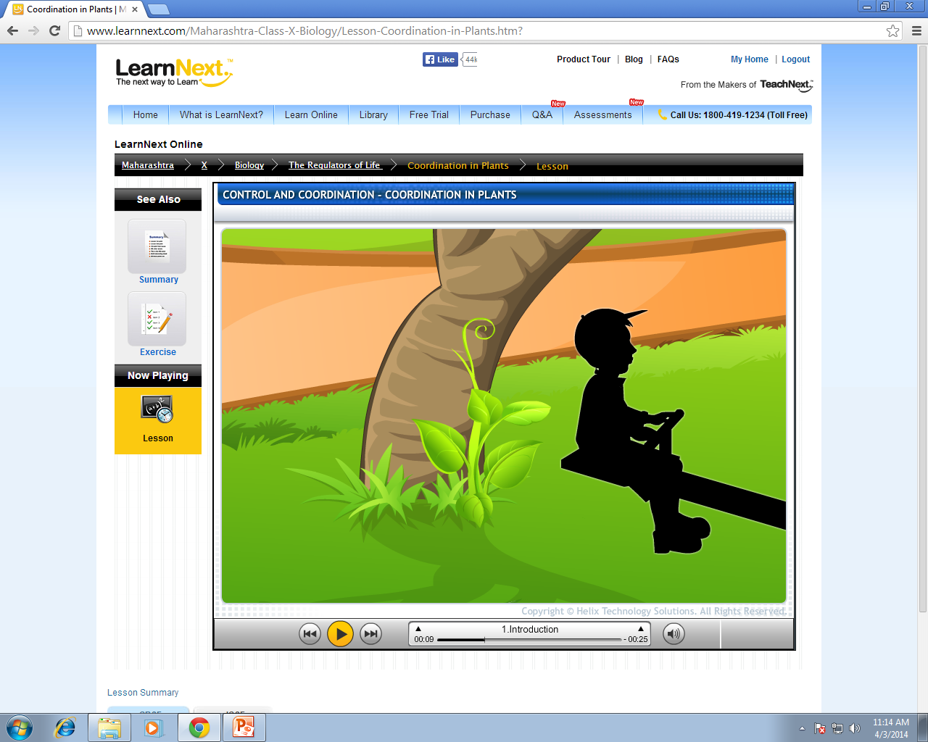
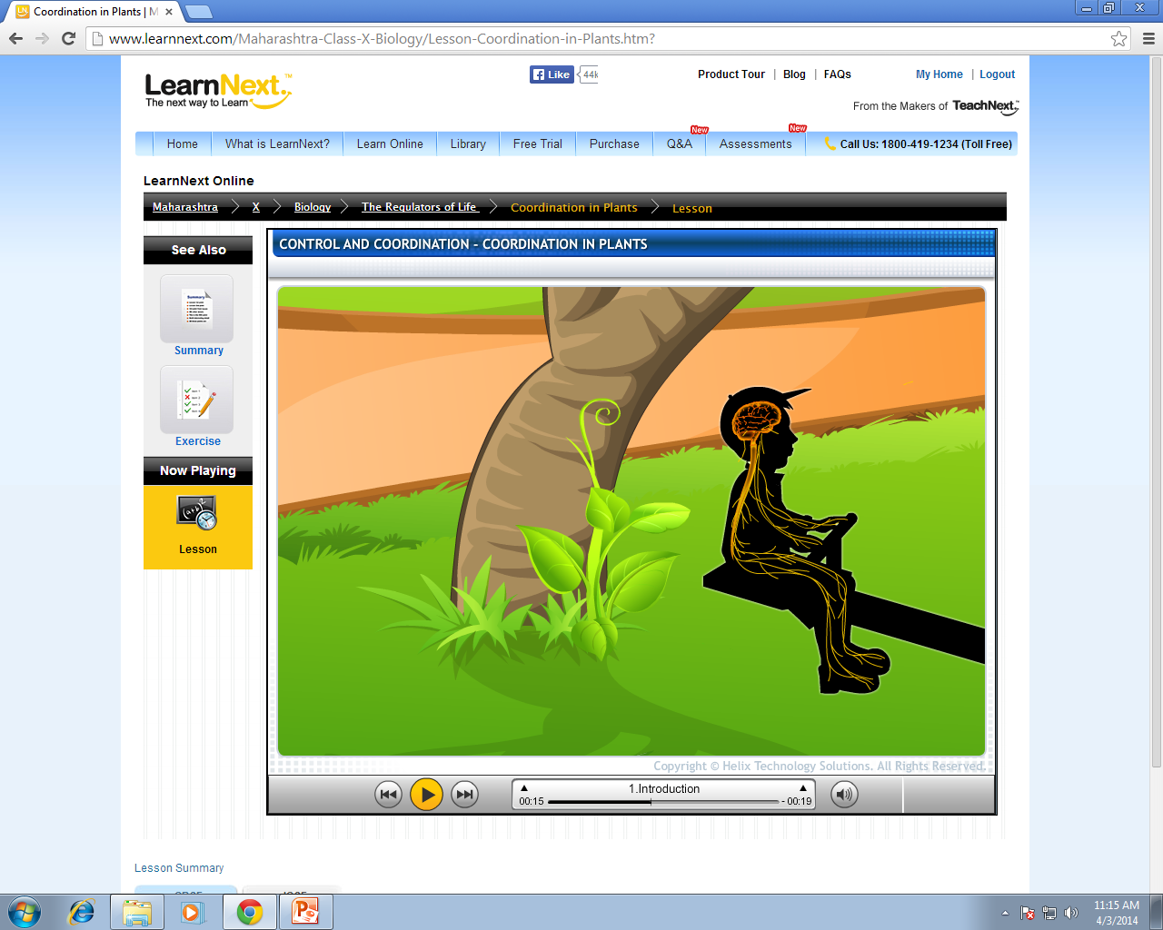
But how do plants move ?
Locomotion is coordinated by nervous system and muscular system
?

Slide 4

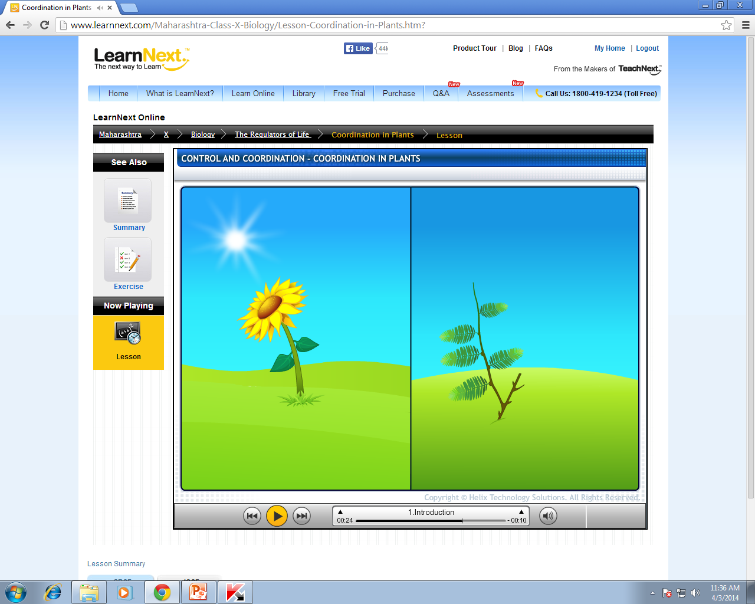

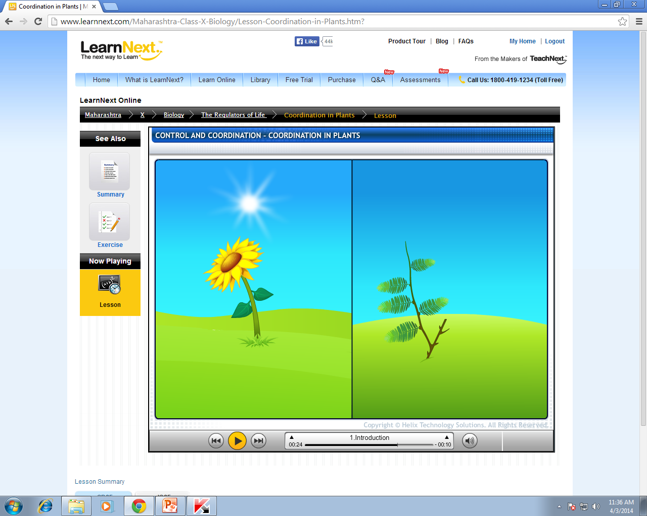










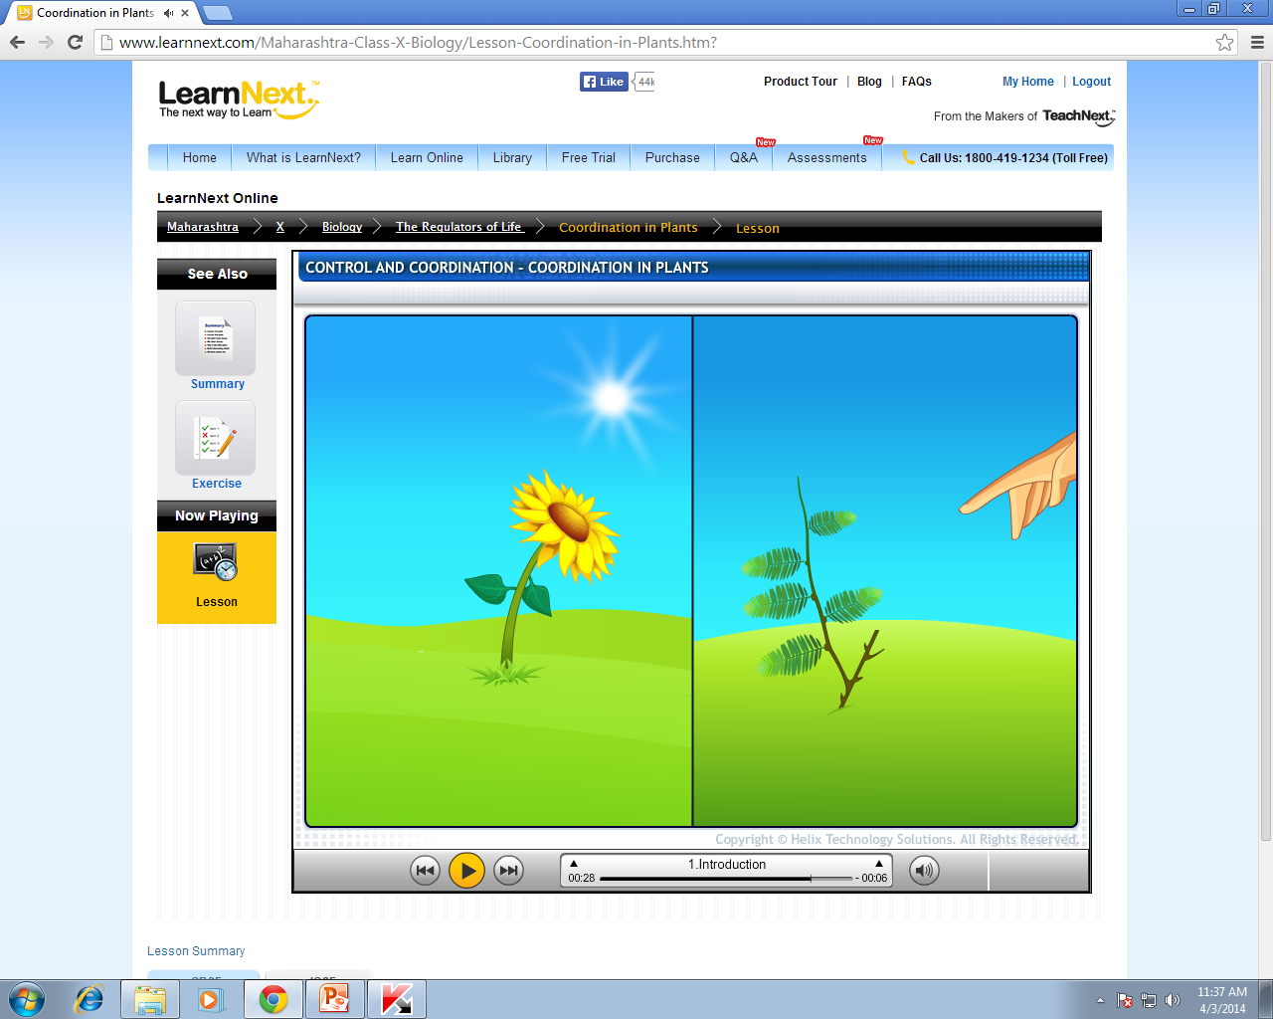








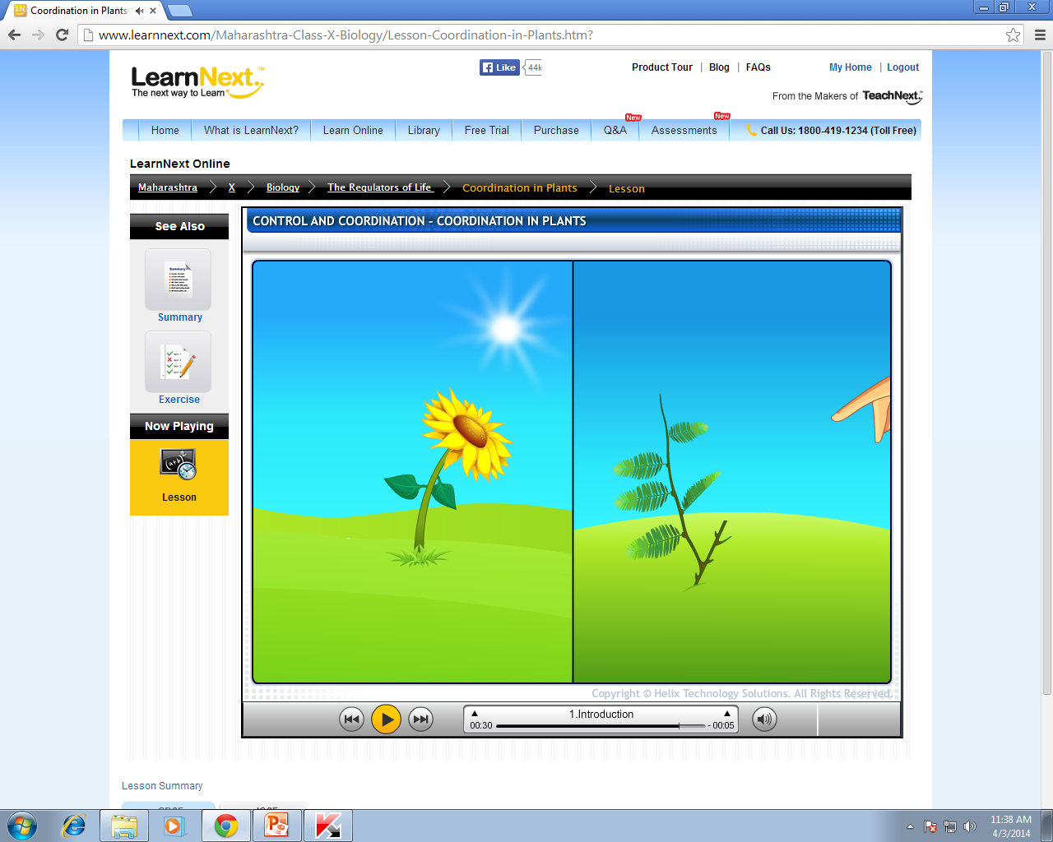

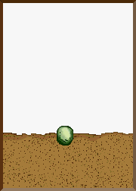

Let us study movements in plants :
Do plants have muscular system and nervous system ?
But what causes movement in plants ?
Plants move in response to external stimulus
and due to growth.
Stimulus is Light
No !!!
The movement is coordinated by chemicals called as
HORMONES
Stimulus is touch

Slide 5
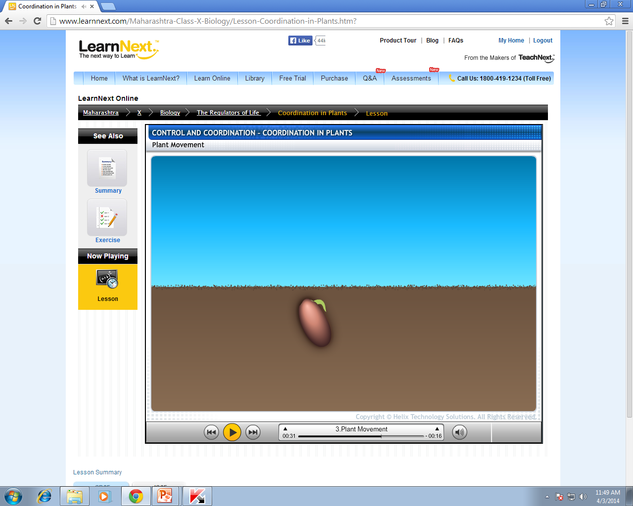










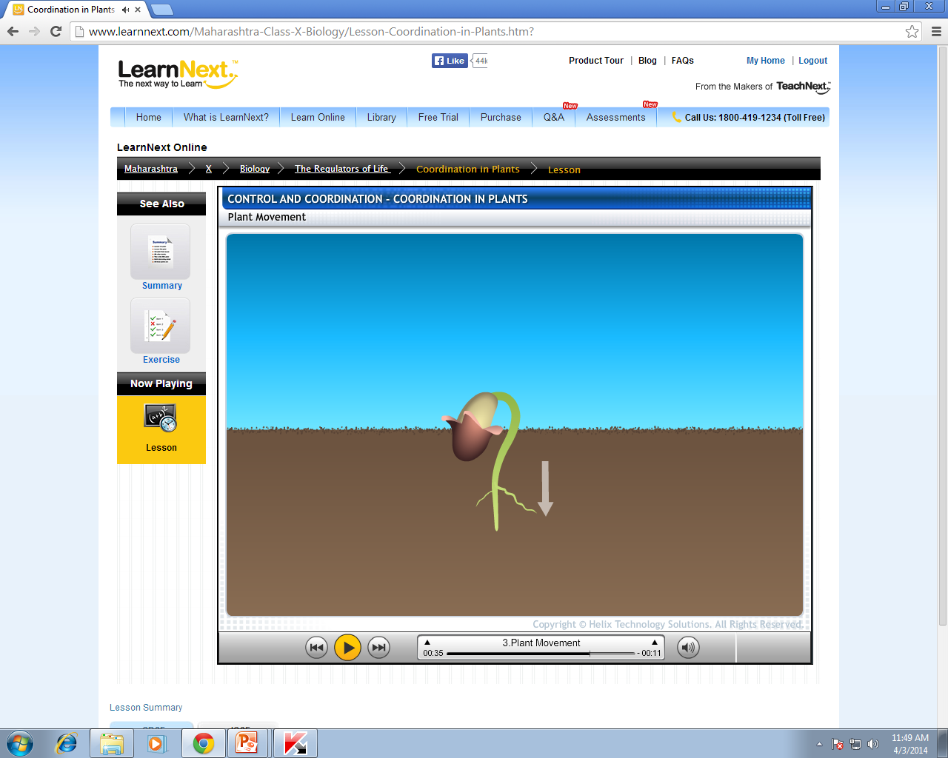



















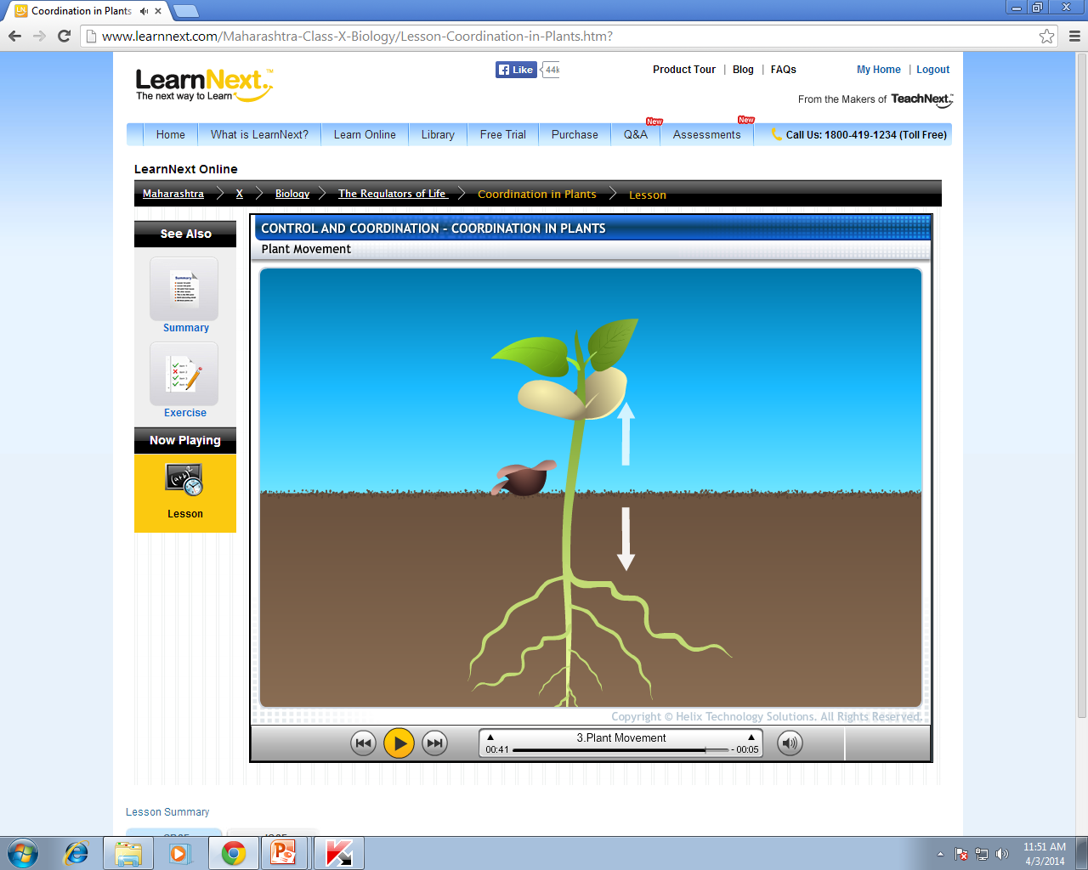
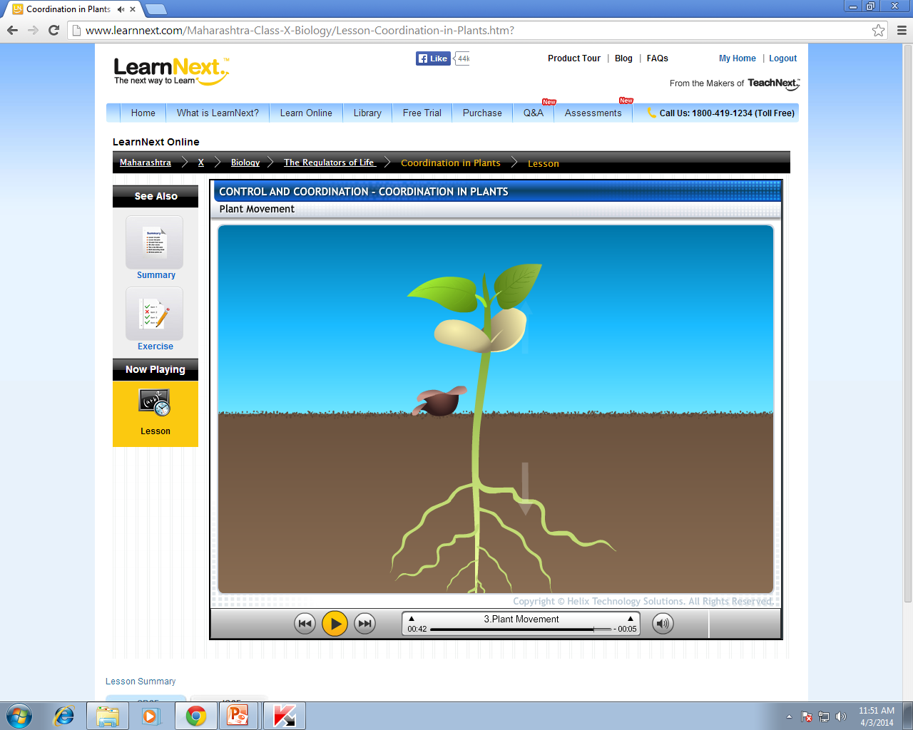

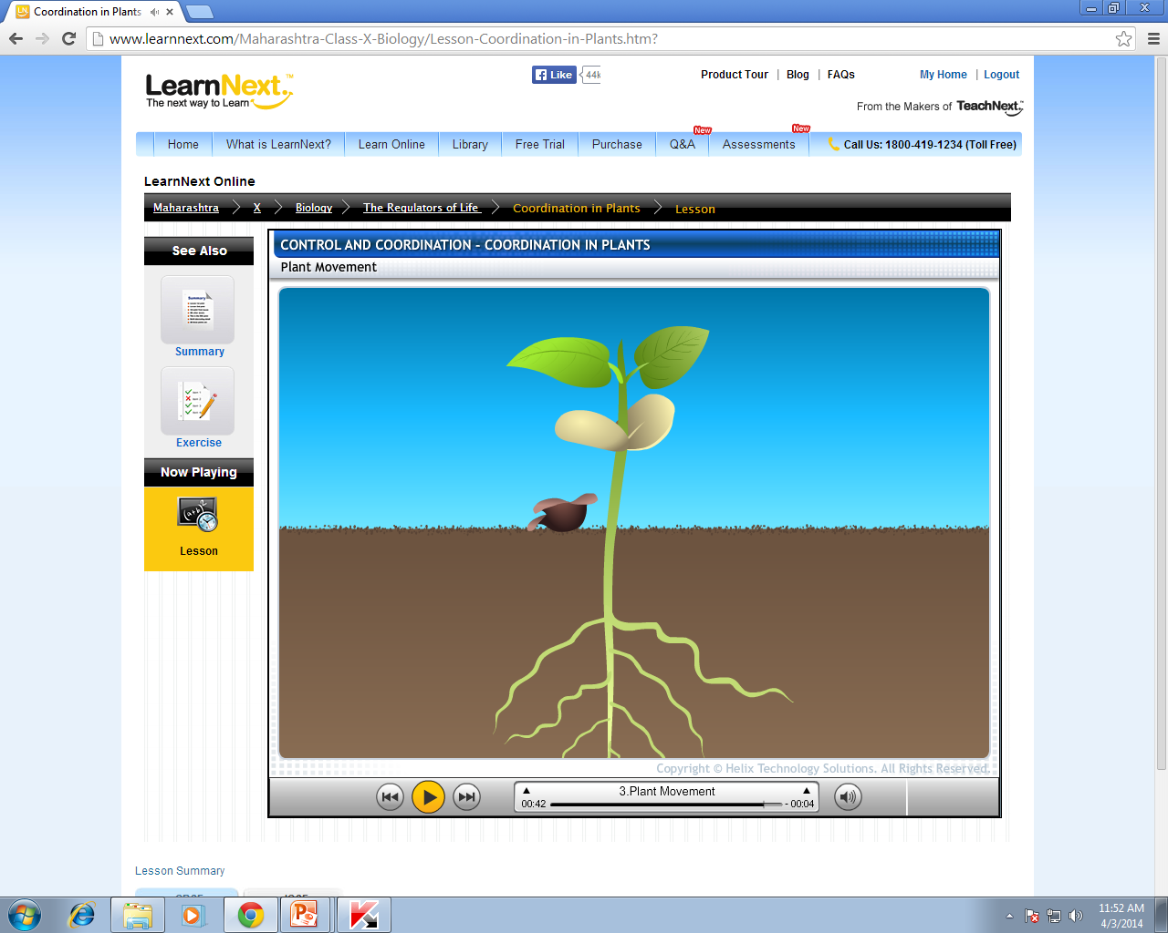


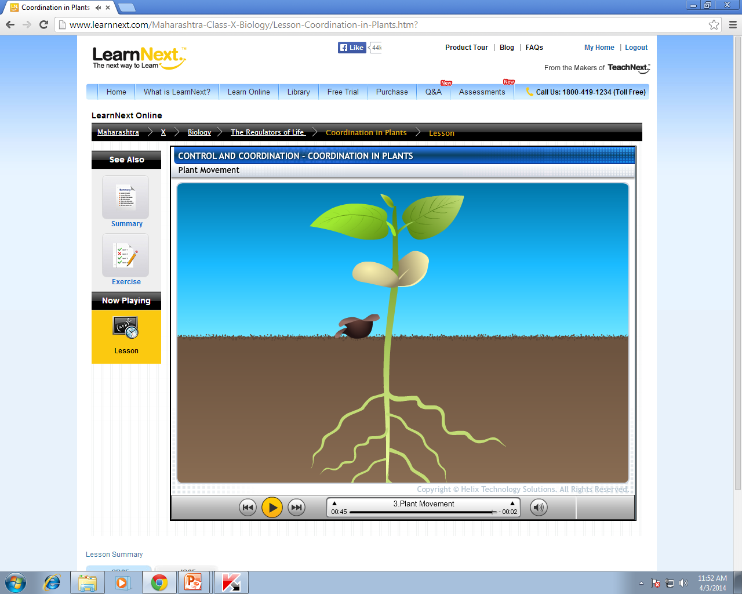


If growth is prevented there will be no Movement
Let us study Plant movements
Growth dependent
Growth independent
Movement is dependent on growth
Movement is not dependent on growth
Due to external stimulus plants shows two types of movements.
Both of these movements are coordinated by
HORMONES
Is this plant growing ?
Is this plant growing ?
Yes
No
Such movements are called as Growth dependent
Such movements are called as
Growth independent

Slide 6
Thank You

